Slide 1
Computer Programming Basics
Jeon, Seokhee
Assistant Professor
Department of Computer Engineering,
Kyung Hee University, Korea

Slide 2
CHAPTER 9
Pointers – Part 1

Slide 3
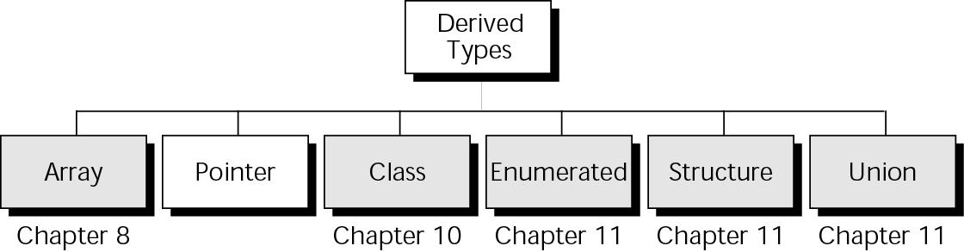
Derived types

Slide 4
Variable and memory
identifier
int main ()
{
int a;
int b;
int c;
a = 1000;
b = 2000;
c = 3000;
}
int a
int b
int c
1000
2000
3000
value

Slide 5
Variable and memory
int main ()
{
int a;
int b;
int c;
a = 1000;
b = 2000;
c = 3000;
}
int a
int b
int c
1000
2000
3000
1004
1008
1012
1016
address

Slide 6
Pointer
int main ()
{
int a;
int b;
int c;
…
int* ptr;
a = 1000;
b = 2000;
c = 3000;
}
int a
int b
int c
1000
2000
3000
1004
1008
1012
1016
int* ptr
NUL
3004
3008

Slide 7
Pointer
int main ()
{
int a;
int b;
int c;
int* ptr;
a = 1000;
b = 2000;
c = 3000;
ptr = &a;
}
int a
int b
int c
1000
2000
3000
1004
1008
1012
1016
memory address of ‘a’
int* ptr
1004
3004
3008

Slide 8
Pointer
‘Pointer’ is
  a variable
  that contains a memory address of other variable
  (does not contain a actual data).
  This is why we call it “Pointer”
  since it is used to POINT other variable.
“포인터는 메모리 주소 값을 갖는 변수”

Slide 9
Operator ‘*’
When * is used as a prefix to a variable name, it means “value” of a pointer.
When it is used as a suffix to a type, it means a pointer of that type.

Slide 10
Operator ‘*’ as “value of”
cout << ptr;
→ 1004
cout << *ptr;
→ 1000
int a
int b
int c
1000
2000
3000
its value
1004
1008
1012
1016
int* ptr
pointed address
1004
3004
3008
Copyright(c) 2009 Kyung Hee University. All Rights Reserved.

Slide 11
Operator ‘*’ as “pointer type definition”
int main ()
{
int a;
int b;
int c;
int* ptr;
a = 1000;
b = 2000;
c = 3000;
}

Slide 12
Operator ‘&’
When the ampersand (&) is used as a prefix to a variable name, it means “address” of variable.
When it is used as a suffix to a type, it means reference parameter.

Slide 13
Operator ‘&’ as “address of”
cout << a;
→ 1000
cout << &a;
→ 1004
int a
int b
int c
1000
2000
3000
1004
1008
1012
1016
address

Slide 14
Operator ‘&’ as “reference parameter”
void exchange(int & num1, int & num2);
int main ()
{
int a;
int b;
a = 1000;
b = 2000;
exchange(a,b);
}

Slide 15

Pointer and data
int* ptr
1004
ptr = &a;
int a
1000
1004
1008

Slide 16
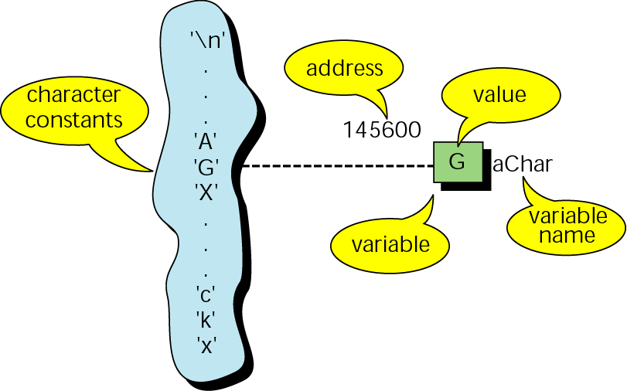
Character constants and variables

Slide 17
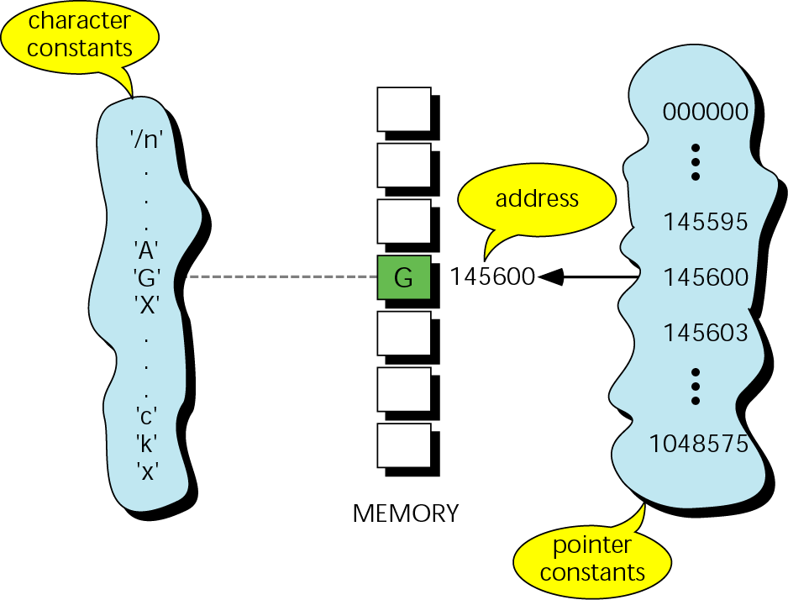
Pointer constants

Slide 18
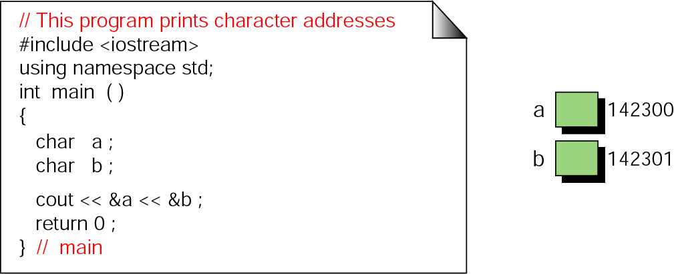
Print character addresses

Slide 19
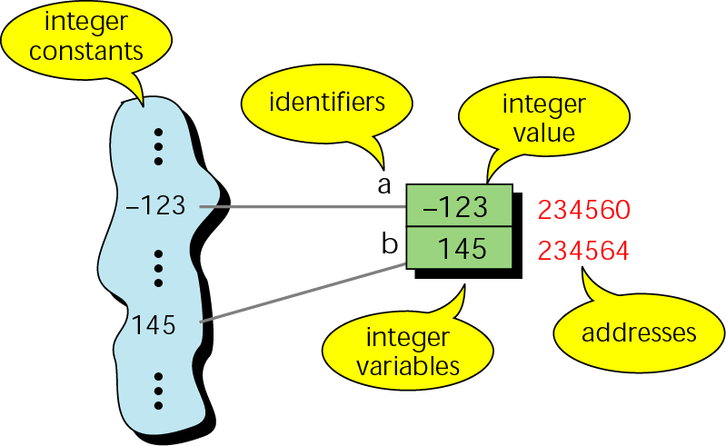
Integer constants and variables

Slide 20
Note:
The address of a variable is the address of the first byte occupied by that variable.

Slide 21
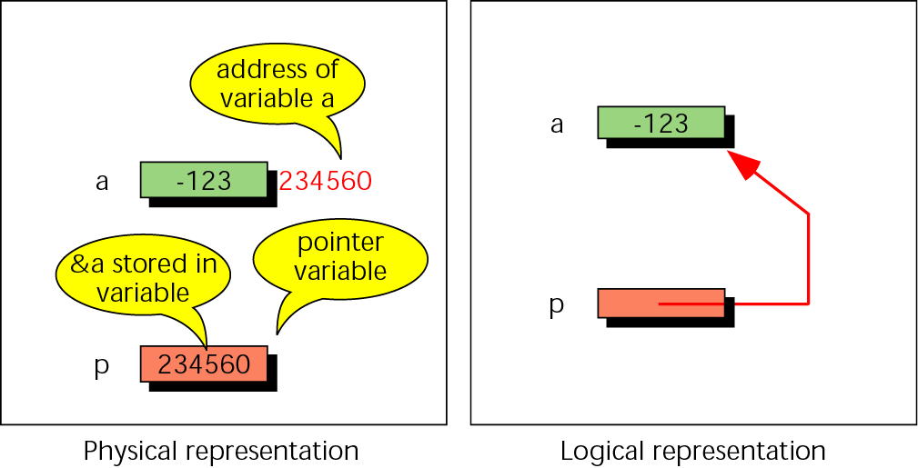
Pointer variable

Slide 22
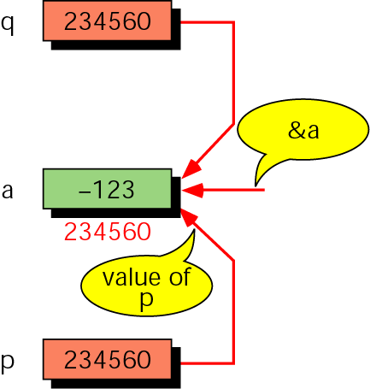
Multiple pointers to a variable

Slide 23
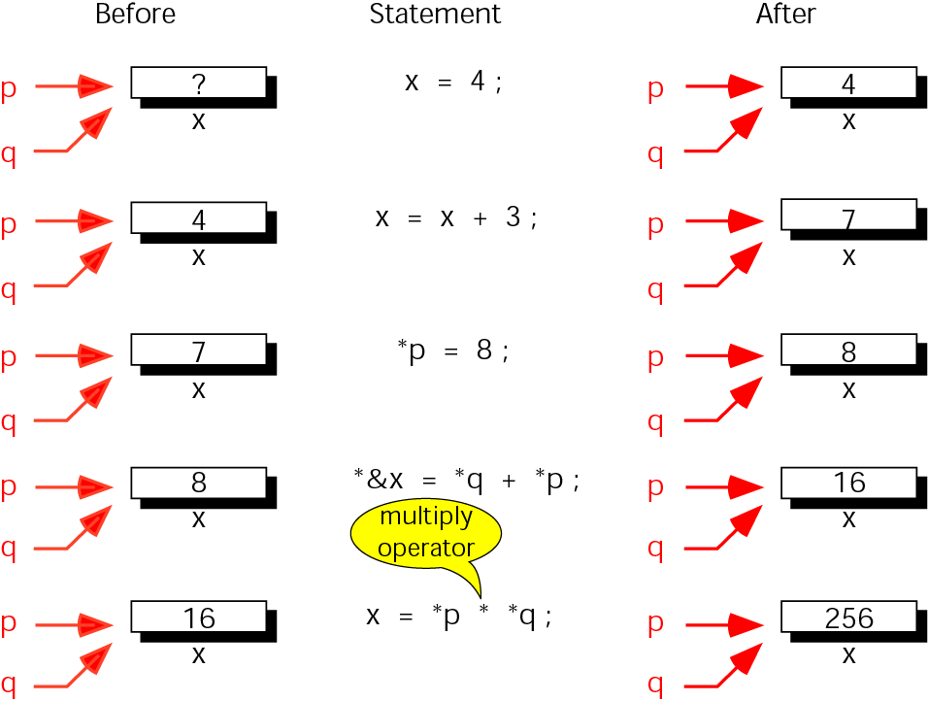
Accessing variables through pointers

Slide 24

Address and indirection operators

Slide 25
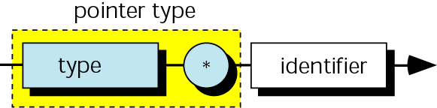
Pointer variable declaration

Slide 26
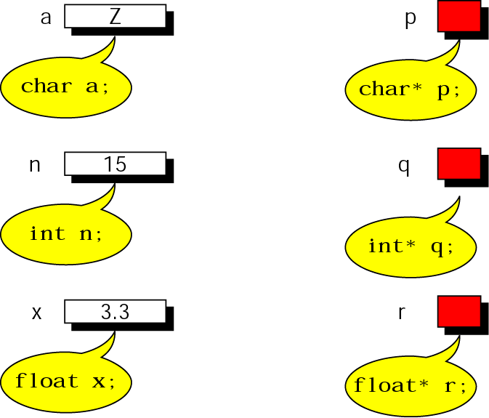
Declaring pointer variables

Slide 27
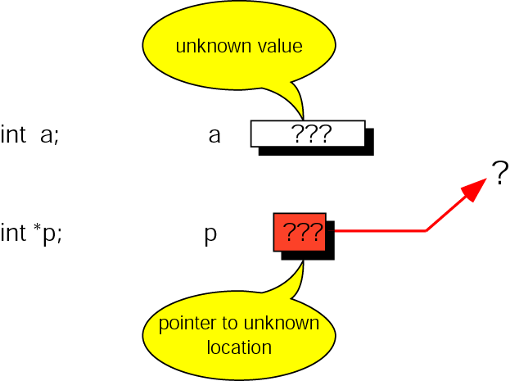
Uninitialized pointers

Slide 28
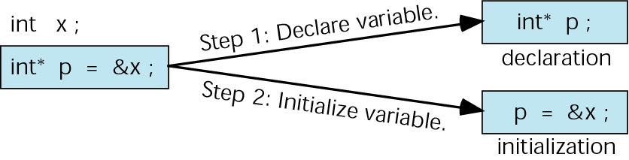
Initializing pointer variables

Slide 29
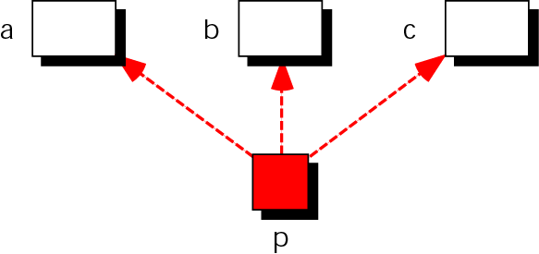
Pointer flexibility

Slide 30
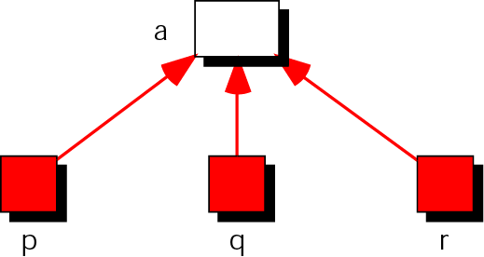
Using one variable with many pointers

Slide 31
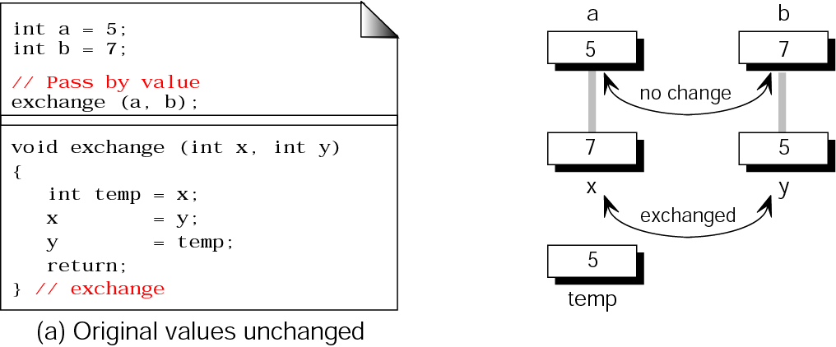
Exchanging values

Slide 32
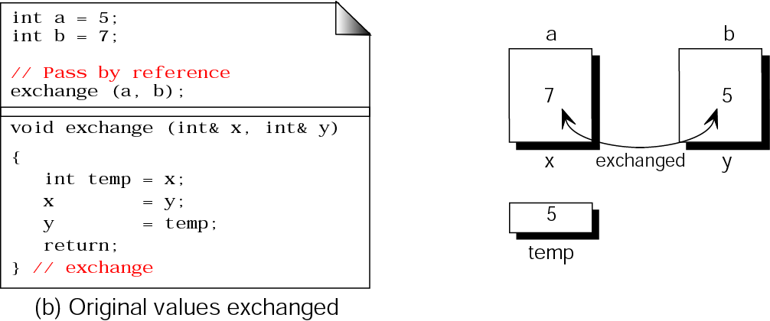
Exchanging values (continued)

Slide 33
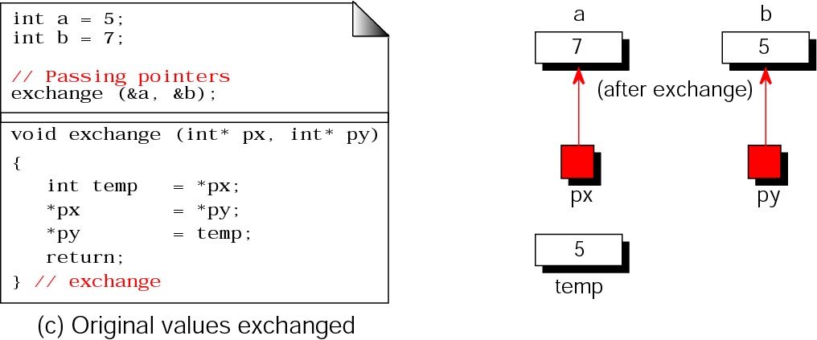
Exchanging values (continued)

Slide 34
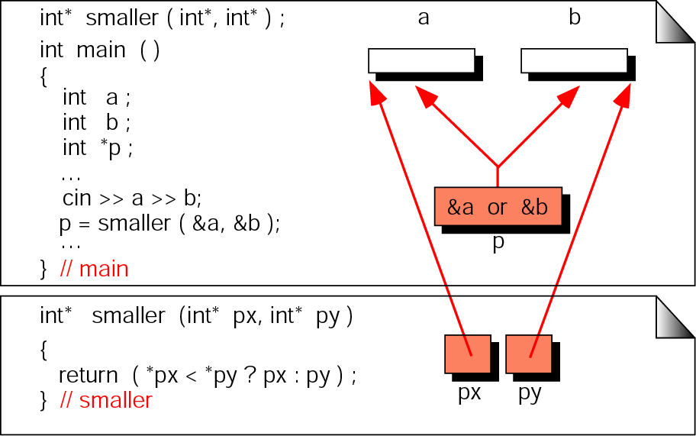
Functions returning pointers

Slide 35
Note:
It is a serious error to return a pointer to a local variable.

Slide 36
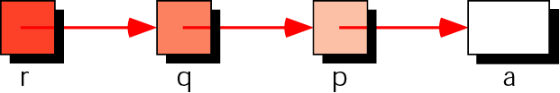
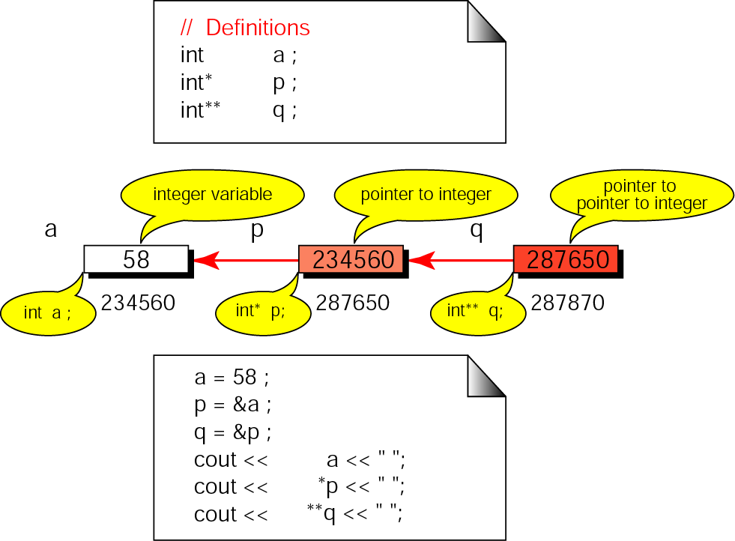
Pointers to pointers

Slide 37
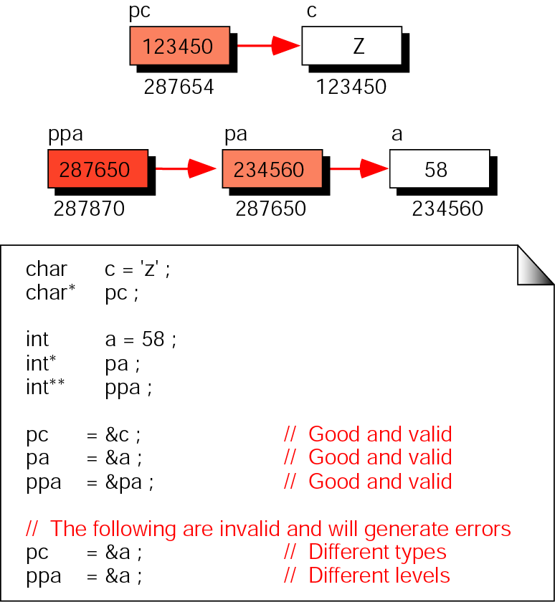
Pointer compatibility

Slide 38
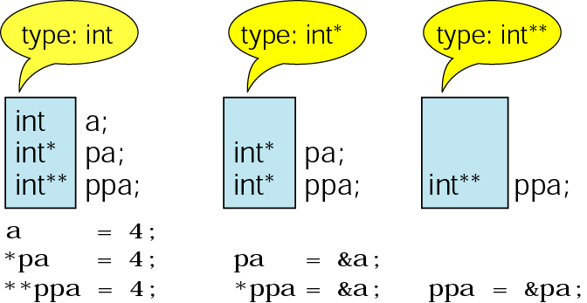
Pointer types must match

